Slide 1

Team Details
  Team name: Lekha.ai
  Team leader name: Jay Gavali
  Problem Statement: Tenants often face complex, jargon-heavy rental agreements that hide unfair clauses, leading to legal vulnerability and financial loss. Many tenants lack the legal expertise to identify "red flags" before signing.

Slide 2
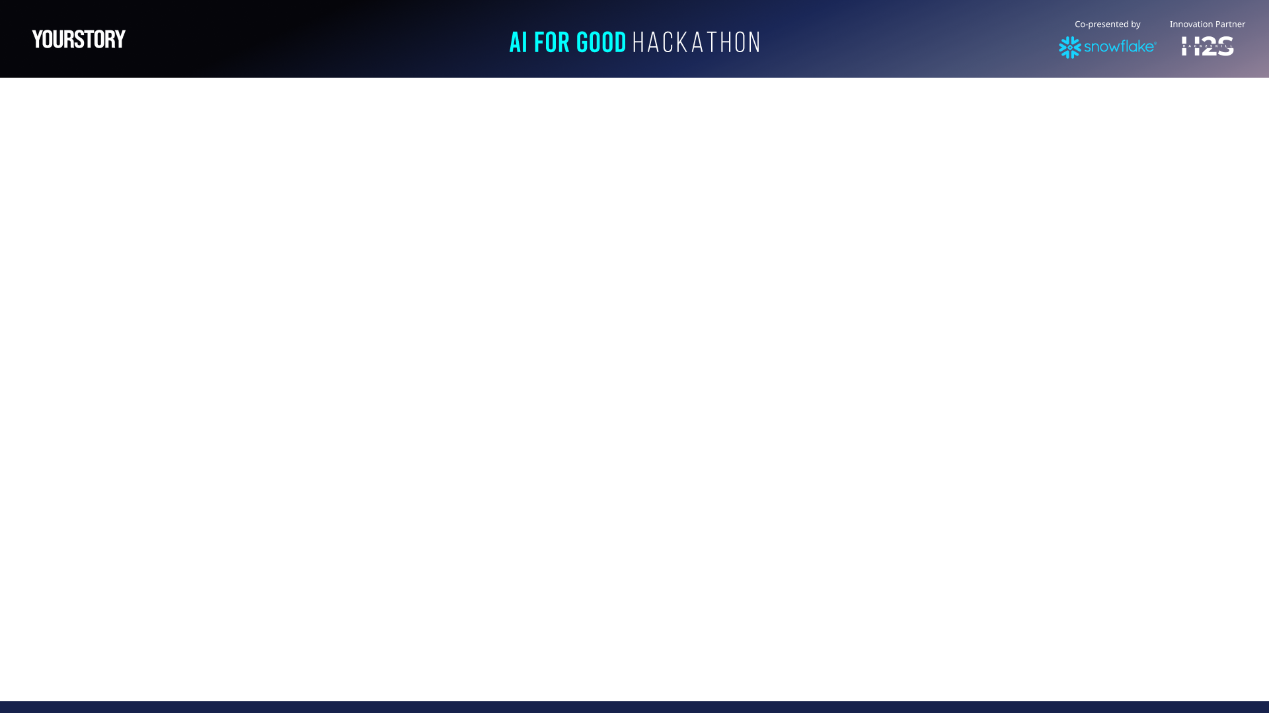
Brief about the idea/protoype
Lekha.ai is a specialized legal-tech web application that uses Generative AI to translate complex rental contracts into plain English
Users upload a PDF, DOCX, or paste lease text. The system runs a dual-layer analysis—combining rule-based keyword detection with deep semantic reasoning via Google Gemini—to provide an instant fairness rating

Slide 3
Opportunities
Market Difference: Unlike generic document summaries, Lekha.ai is context-aware
of Indian Tenancy Laws and regional state-specific regulations.
Problem Solving: It empowers tenants to negotiate terms before signing,
preventing future legal disputes.
USP (Unique Selling Proposition):
      1.The Lekha Score: A proprietary 0-100 Danger Rating scale.
    2.Dual-Layer Analysis: Merges hardcoded legal safety rules with LLM intelligence.
    3.Regional Awareness: Tailored analysis based on the specific Indian state
    of the property.

Slide 4
List of features offered by the solution
Type here…
AI Risk Assessment: Detects high-priority issues like illegal security
deposit retention or unauthorized entry clauses.
Multi-Format Processing: Full support for PDF, Word, and text-based
documents.
Fair Clause Highlighting: Identifies standard, protective terms to reassure
the tenant.
Actionable Recommendations: Provides specific next steps and negotiation
advice.
Secure Auth System: Encrypted user accounts for managing analysis history.

Slide 5
Process flow diagram or Use-case diagram
Step 1: User logs in and uploads a rental agreement (PDF/DOCX/Text).
Step 2: Flask backend extracts text and executes a rule-based scan for
"Danger Keywords".
Step 3: Extracted text and preliminary findings are sent to the Google Gemini
API.
Step 4: Gemini performs a semantic legal audit and returns a structured JSON
report.
Step 5: UI renders a color-coded dashboard with the Lekha Score, Red Flags,
and Recommendations.

Slide 6
Architecture diagram of the proposed solution
Frontend: HTML5, CSS3, and Vanilla JavaScript (SPA architecture).
Backend API: Python Flask server managing document processing and
AI orchestration.
Database: MySQL for secure user profile management and credential
hashing (Werkzeug).
AI Integration: Google Gemini 1.5 Flash for high-speed, accurate legal
analysis.

Slide 7
Tech Stack
Core Languages: Python, JavaScript, SQL.
Frameworks: Flask, Flask-CORS.
Document Parsing: PyPDF2, python-docx.
AI & ML: Google Generative AI (Gemini SDK).
Environment: Dotenv for secure API management.

Slide 8
Snowflake tools and technology used
AI Engine: Utilizes Gemini's large context window to process entire
15+ page contracts in seconds.
Scalability: The architecture is designed to scale horizontally; future
iterations can utilize Snowflake for large-scale legal data warehousing
and trend analysis across thousands of analyzed leases.

Slide 9
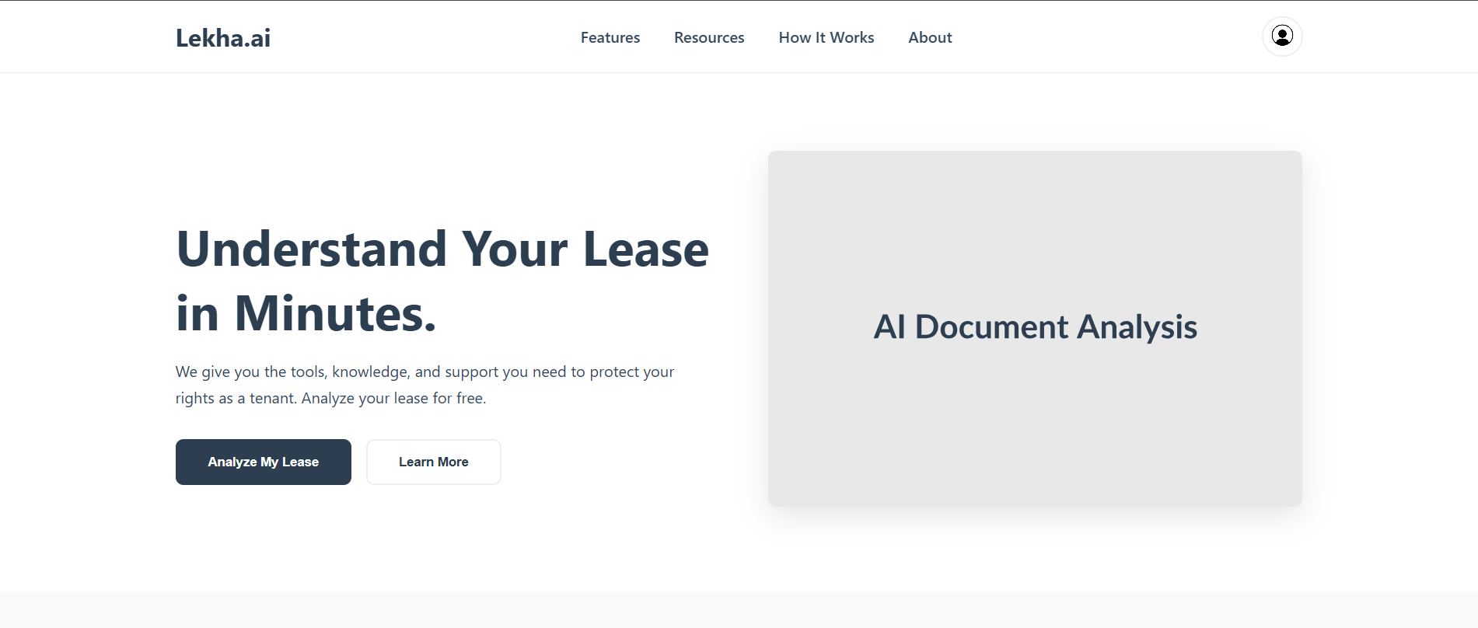
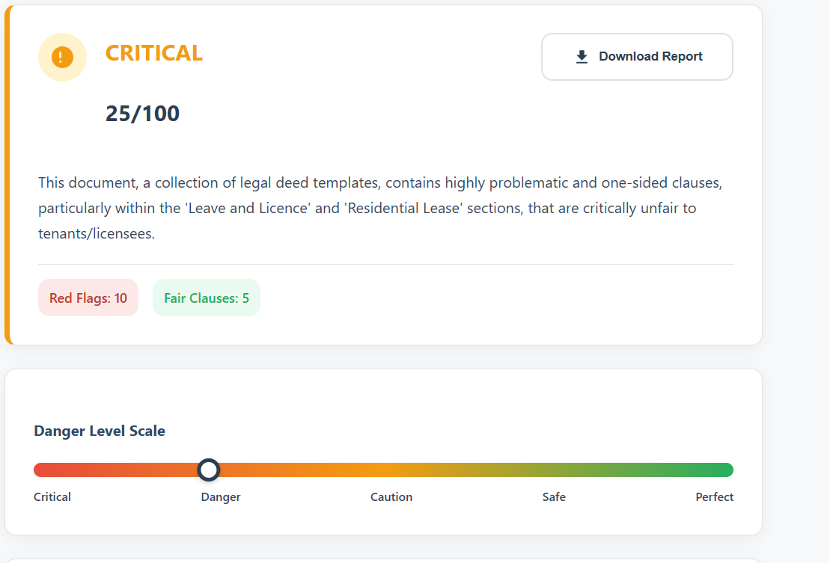
Snapshots of the prototype
Snapshot 1: Landing page featuring the professional Lekha.ai front page
Snapshot 2: Interactive analyzer view with the "Danger Marker" and Lekha Score.

Slide 10
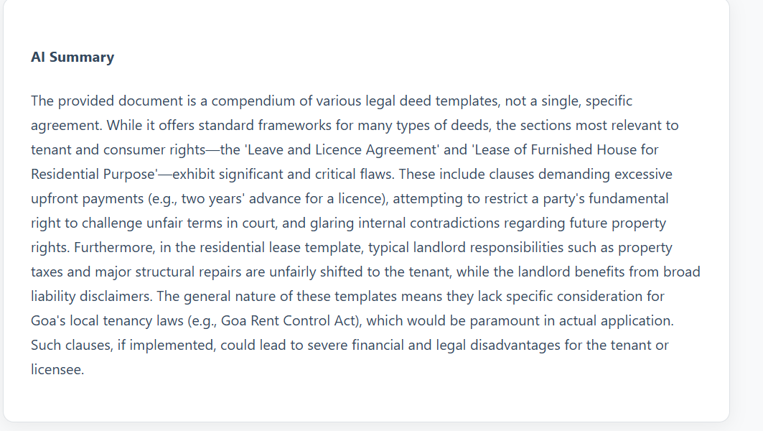
Snapshot 3: Detailed Ai Summary view highlighting Red Flags and next steps.

Slide 11
Estimated implementation cost (optional)
Compute: Minimal (serverless backend).
AI Costs: Variable based on API usage (Gemini Flash offers
a high-value, low-cost tier).
Infrastructure: Cloud hosting (AWS/Azure) and Managed MySQL
instances.

Slide 12
Additional Details/Future Development (if any)
Negotiation Assistant: AI-drafted emails to landlords requesting
clause revisions.
Regional Languages: Support for agreements in Hindi, Marathi, and
other Indian vernaculars.
Legal Marketplace: Connecting users to verified tenant-rights lawyers for
critical cases.

Slide 13
GitHub and Demo video URL
GitHub Repository:
https://github.com/jay192005/Rent_Agreement_Checker
Demo Video:
https://drive.google.com/file/d/155baVDW1DC3aFpl1P60M8U9Koi186Ipa/view?usp=sharing

Slide 14


